Slide 1
LR Parsers

Slide 2
LR Parsers
The most powerful shift-reduce parsing is:
LR(k) parsing.
Left to right scanning
Right-most derivation
k lookhead (k is omitted → it is 1)

Slide 3
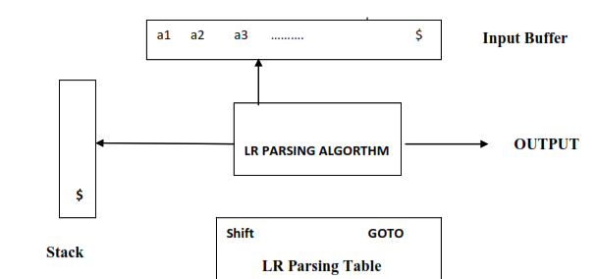
Components of LR Parsing

Slide 4
Input buffer:
It contains the string to be parsed followed by a $ Symbol.
Stack:
It containing a sequence of grammar symbols with a $ at the bottom of the stack,
Initially contains the Initial state of the parsing table on top of $.

Slide 5
Parsing table (M):
It is a two dimensional array M[ state, terminal or Non terminal] and
It contains two parts
1. ACTION Part
2D array indexed by state and the Input symbol,
i.e. ACTION[state][input].
1. Shift.
2. Reduce
3. Accept
4. Error entry.

Slide 6
2. GO TO Part
2D array indexed by state and a Non terminal,
i.e. GOTO[state][NonTerminal].
A GO TO entry has a state number in the table.

Slide 7
Classification of LR Parsers
1. LR ( 0 )
2. SLR ( 1 )
3. CLR ( 1 )
4. LALR ( 1 )

Slide 8
LR(0)
Steps are
1. Add Augment production
2. Create Canonical collection of LR ( 0 ) items
3. Construct the LR ( 0 ) Parsing table
4. Construct the Parse Table

Slide 9
Ex: Construct LR(0) parser and verify
the string “abb” is accepted or not
S → AA, A → aA | b
Sol: Given
S→AA ➔R₁
\ A→aA ➔R₂
A→b ➔R₃
Step1: Augmented Grammar
S’→S
S→AA
A→aA
A→b
:

Slide 10
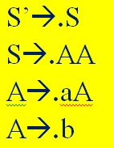
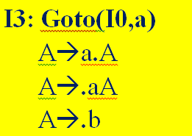

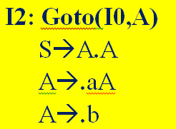

Step2: Closure(S’→S): I0

Slide 11

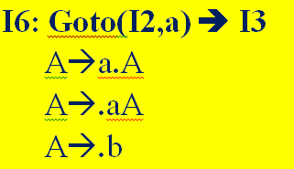


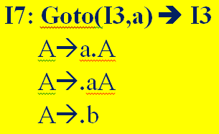


Slide 12
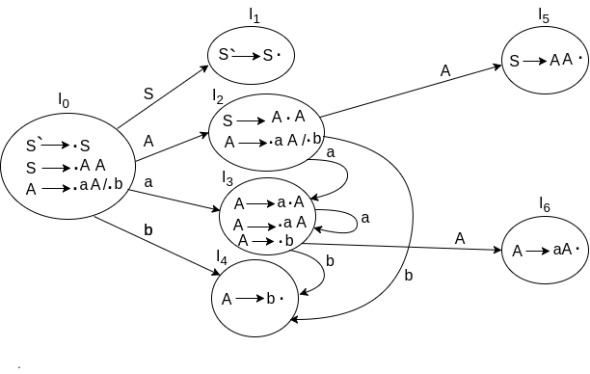
DFA

Slide 13
Step3: Parse Table Construction
Identify ended productions for Placing Reduction
I4 : A → b• →R3
I5 : S → AA• →R1
I6 : A → aA• →R2

Slide 14
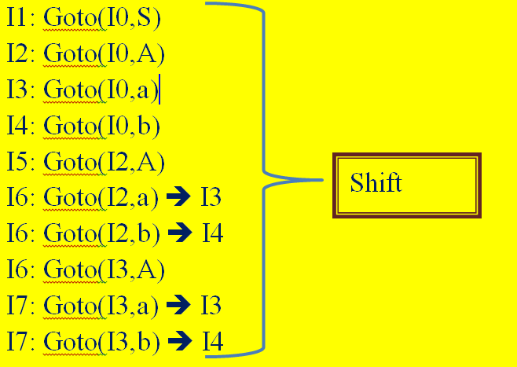
Consider Items for SHIFT action

Slide 15
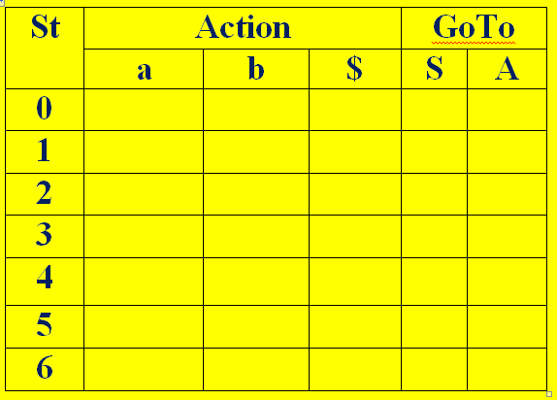
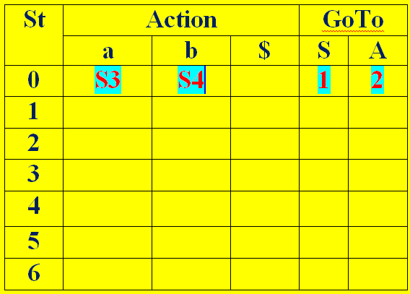
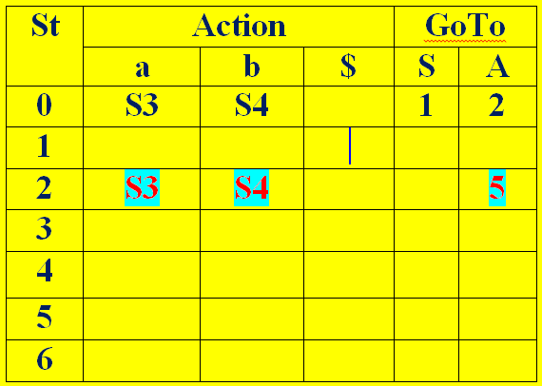
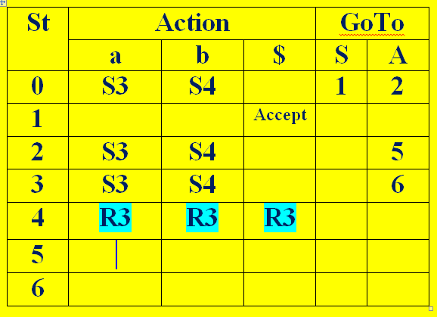
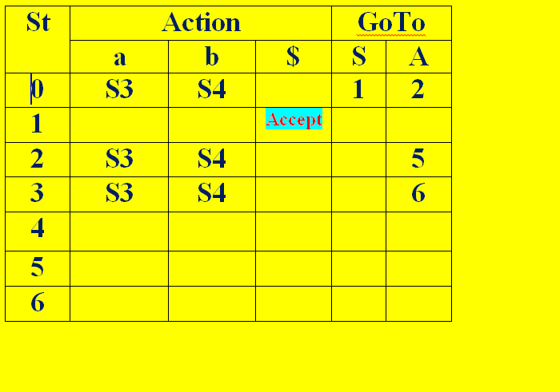
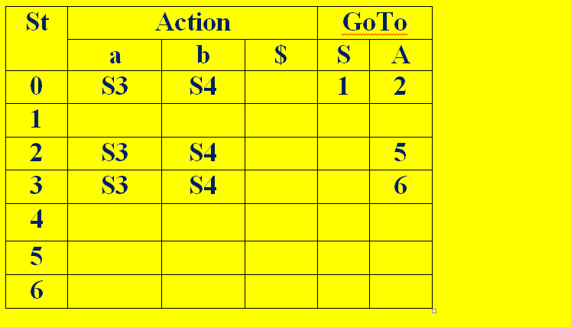
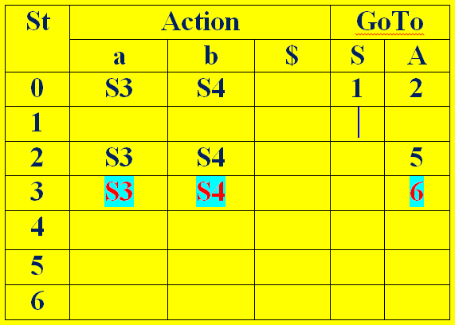
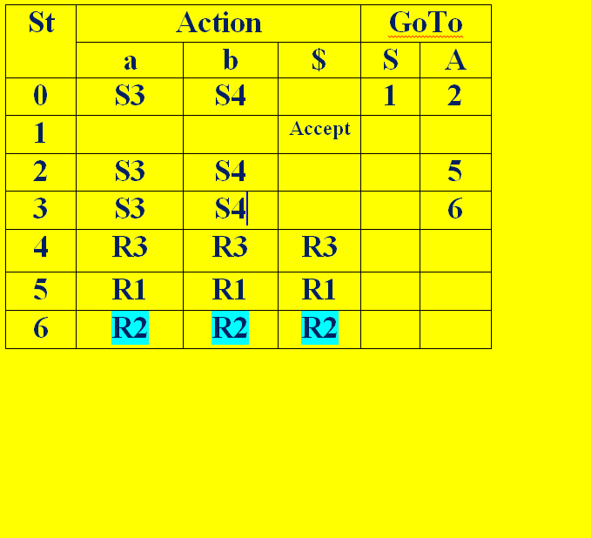
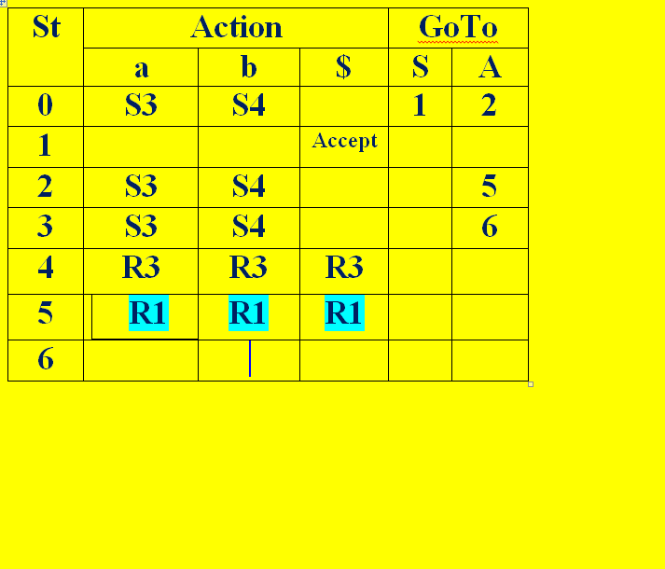
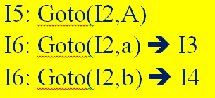
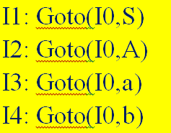
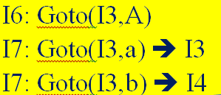
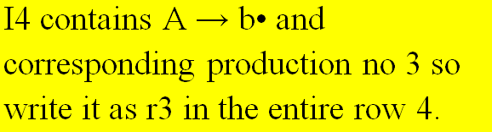
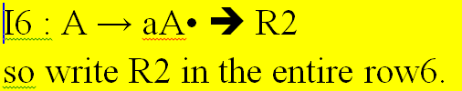
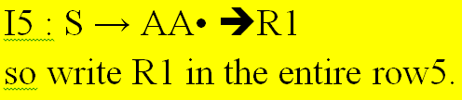

Parse Table:

Slide 16
Stack Implementation for Input string “abb”
Stack I.Buffer Action
$0 abb$ Shift
$0a3 bb$ Shift
$0a3b4 b$ A→b
$0a3A6 b$ A→aA
$0A2 b$ Shift $0A2b4 $ A→b
$0A2A5 $ S→AA
$0S1 $ Accept
LR0 | Action |  |  | GoT
 | a | b | $ | S | A
0 | S3 | S4 |  | 1 | 2
1 |  |  | Ac
2 | S3 | S4 |  |  | 5
3 | S3 | S4 |  |  | 6
4 | R3 | R3 | R3
5 | R1 | R1 | R1
6 | R2 | R2 | R2

Slide 17
SLR ( 1 )
Simple LR Parsing
Same like LR(0) parsing except in the parsing table.
Place the reduce move only in the follow of left hand side.
Use canonical collection of LR (0) items.

Slide 18
Steps for construction:
1. Add Augment production
2. Create Canonical collection of LR ( 0 ) items
3. Construct the LR ( 0 ) Parsing table
4. Construct the Parse Table

Slide 19
Ex: Construct SLR(1) parser and verify
the string “abb” is accepted or not
S → AA, A → aA | b
Sol: Given
S→AA ➔R₁
\ A→aA ➔R₂
A→b ➔R₃
Step1: Augmented Grammar
S’→S
S→AA
A→aA
A→b
:

Slide 20
Step2: Closure(S’→S): I0

Slide 22
Step3: Parse Table Construction
Find FIRST and FOLLOW:
Given S→AA
A→aA
A→b
First(S)=First(AA)= First(A)={a,b}
First(A)={a,b}
Follow(S)={$} (by case1)
Follow(A):
S→AA; A→aA

Slide 23
Follow(A):
S→AA
Compare by A→αBβ where A=S,α=A,B=A,β=ϵ
By case3:
Follow(A)=Follow(S)={$}
Compare by A→αBβ where A=S,α=ϵ,B=A,β=A
By case2:
Follow(A)=First(A)={a,b}
A→aA
here β= ϵ So by case3 Follow(A)=Follow(A)
Finally Follow(A)={a,b,$}

Slide 24
First(S)=First(AA)= First(A)={a,b}
First(A)={a,b}
Follow(S)={$}
Follow(A)={a,b,$}

Slide 25
Step3: Parse Table Construction
Identify ended productions for Placing Reduction
I4 : A → b• →R3➔{(4,a)(4,b)(4,$)}.
I5 : S → AA• →R1➔ {(5,$)}.
I6 : A → aA• →R2➔ {(6,a)(6,b)(6,$)}.

Slide 26
Consider Items for SHIFT action

Slide 27
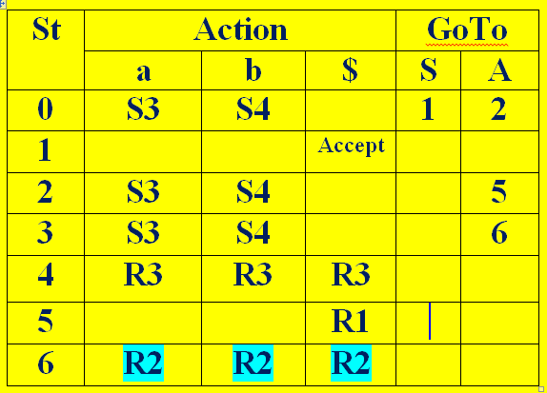
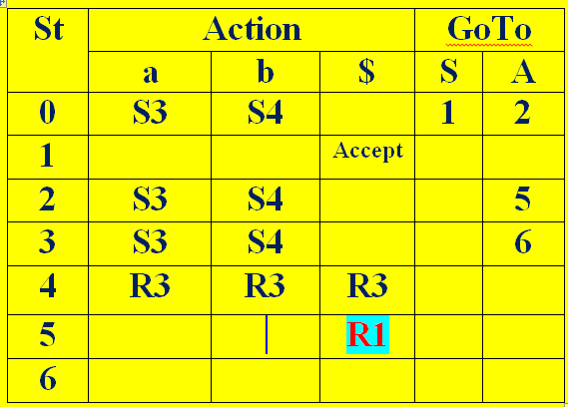
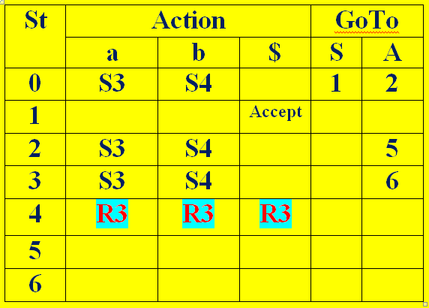
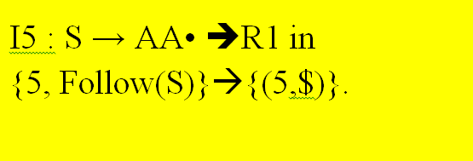
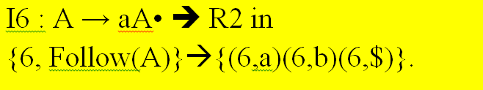
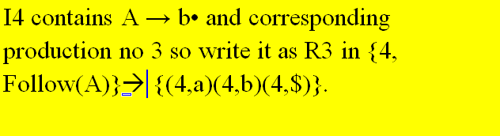
Parse Table:

Slide 28
Stack Implementation for Input string “abb”
Stack I.Buffer Action
$0 abb$ Shift
$0a3 bb$ Shift
$0a3b4 b$ A→b
$0a3A6 b$ A→aA
$0A2 b$ Shift $0A2b4 $ A→b
$0A2A5 $ S→AA
$0S1 $ Accept
SLR | Action |  |  | GoT
 | a | b | $ | S | A
0 | S3 | S4 |  | 1 | 2
1 |  |  | Accept
2 | S3 | S4 |  |  | 5
3 | S3 | S4 |  |  | 6
4 | R3 | R3 | R3
5 |  |  | R1
6 | R2 | R2 | R2

